Slide 1
THE EXPANSION OF MASS CULTURE AND MASS LEISURE
The Roaring Twenties = a time of vibrant and dynamic popular culture
Berlin became a center of theaters, cabarets, cinemas, and jazz clubs
Dance crazes - the Charleston, etc.
Josephine Baker
Flappers = new liberated, unconventional women
Jazz = new musical form that originated with African-American musicians in the USA
1. 1920’s called “the Jazz Age”
2. Improvised qualities and forceful rhythms
3. King Oliver, Bix Beiderbecke, Jelly Roll Morton

Slide 2
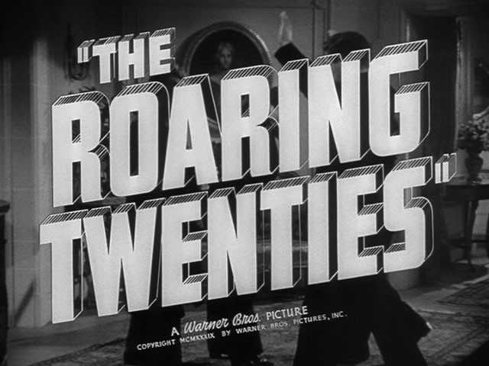
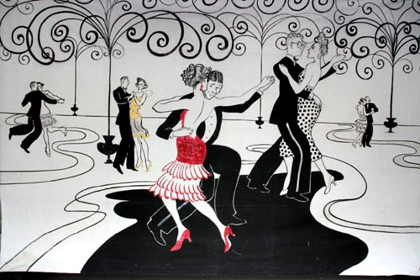
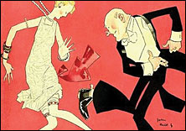
THE CULTURE OF THE 1920’s
DRINK, DANCE, AND PARTY -> A WILD
NEW POPULAR CULTURE AND SOCIAL
ATTITUDES APPEAR

Slide 3
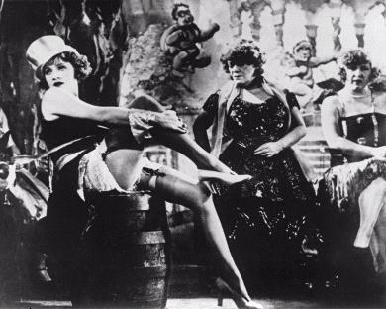
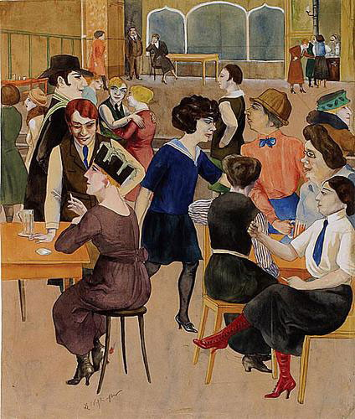
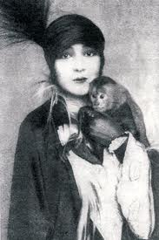
WEIMAR BERLIN
BERLIN AFTER
WW I AND
BEFORE
HITLER IS THE
CENTER OF A NEW
WILD, AVANT
GARDE, ARTSY, SCANDALOUS CULTURE AND SCENE

Slide 4
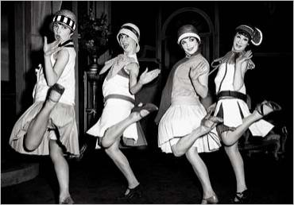
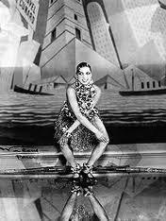
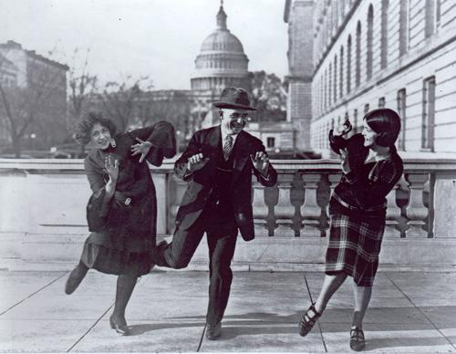
THE CHARLESTON -> THE NEW DANCE CRAZE OF THE 1920’S

Slide 5
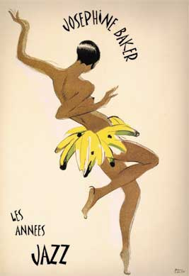
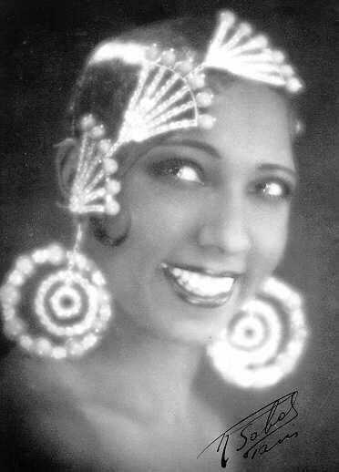
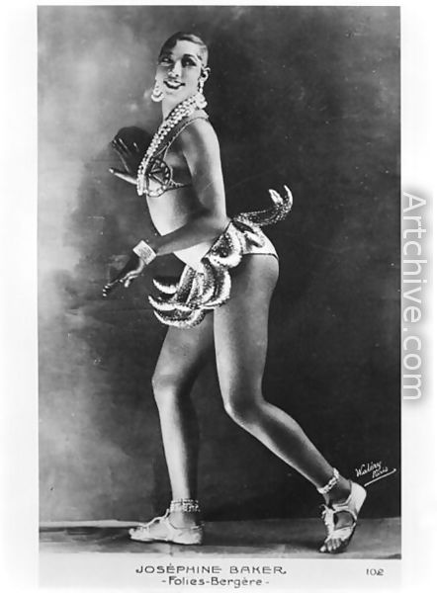
JOSEPHINE
BAKER –
AMERICAN
PERFORMER
WHO BECOMES
A HUGE
SENSATION IN
EUROPE -> THE SHOCKING, PARTIALLY NUDE
“BANANA DANCE”

Slide 6
JOSEPHINE
BAKER –
AMERICAN
PERFORMER
WHO BECOMES
A HUGE
SENSATION IN
EUROPE -> THE SHOCKING, PARTIALLY NUDE
“BANANA DANCE”

Slide 7
ART BETWEEN THE WARS
Art -
Abstract painting
Fascination with the absurd
Fascination with the contents of the unconscious

Slide 8
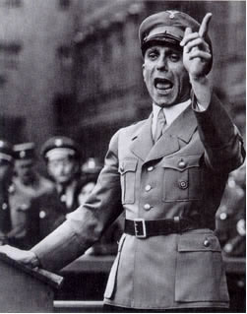
RADIO AND MOVIES
A revolution in mass communications
Radio –
1. Marconi discovers “wireless” radio waves
2. Permanent radio broadcasting facilities set up 1921-22
3. Mass production of radios/receiving set begins
4. 1926 the British Broadcasting Corporation (BBC) is established as public corporation
Motion Pictures –
1. Began as novelty in the 1890’s
2. First full-length motion pictures produced before WW I - Quo Vadis, Birth of a Nation
3. By 1939 forty of adults in industrialized nations attended movies once a week
Marlene Dietrich - German film actress/The Blue Angel
Radio and movies used for propaganda
Joseph Goebbels = Nazi minister of propaganda
The Triumph of the Will - documentary/propaganda film showing the 1934 Nazi party rally at Nuremberg
GEOBBELS – NAZI MINISTER OF
PROGANDA -> NAZIS WERE
MASTERS OF THE USE OF NEW
MODERN COMMUNICATIONS
TECHNOLOGY

Slide 9
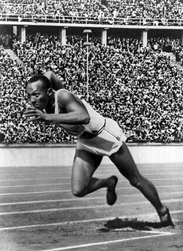
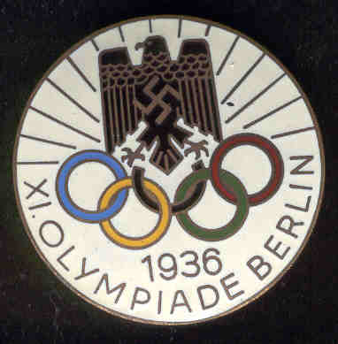
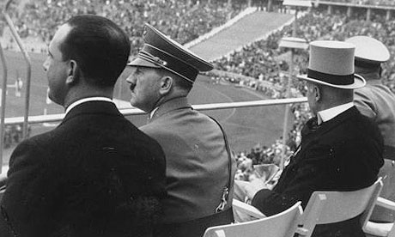
MASS LEISURE
New work patterns allow for expanded amount of free time available - by 1920 the eight hour day was the norm in Northern and Western Europe
Professional sports –
football (soccer) and the creation of the World Cup in 1930
Stadium building in the 1920’s-30’s
The 1936 Olympics in Berlin

Slide 10
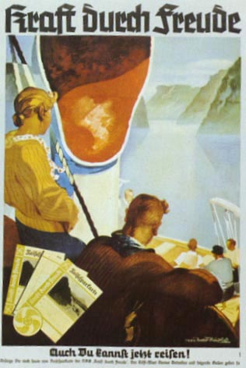
Travel as mass leisure activity -
The beginnings of air travel = just for the wealthy and elite
Trains, buses, and private cars made travel possible
Excursions to beaches and resorts - Brighton in England
Totalitarian regimes used mass leisure activities to control their populations –
The Dopolavoro (Afterwork) in Mussolini’s Italy - fascist organized and supervised recreation
Kraft durch Freude (Strength Through Joy) - Nazi recreation program
Mass culture and mass leisure =
Increasing homogeneity in national populations - everyone acting and becoming the same
Replacement of local culture with a national and international culture
Mass production and mass consumption - same products sold and bought by all

Slide 11
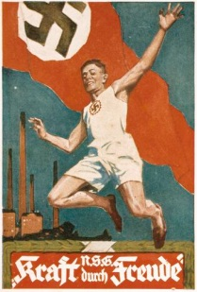
STRENGTH THROUGH
JOY

Slide 12
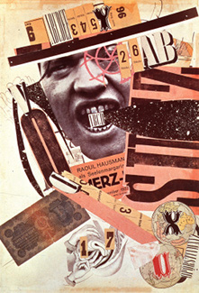
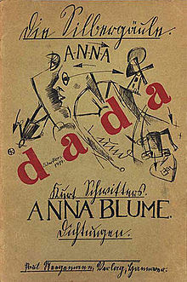
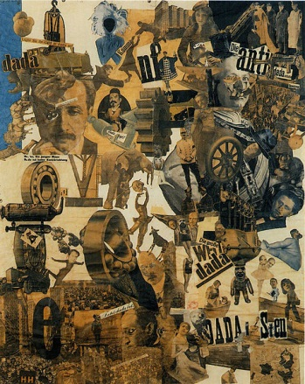
THE DADA
MOVMENT
Expression of the purposelessness of life
Absurdity and ridiculousness
The creation of anti-art

Slide 13
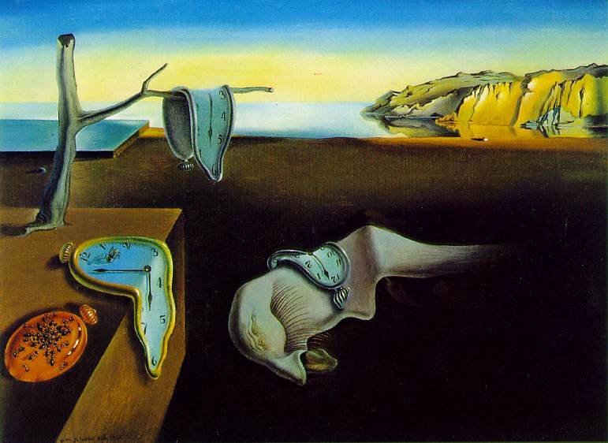
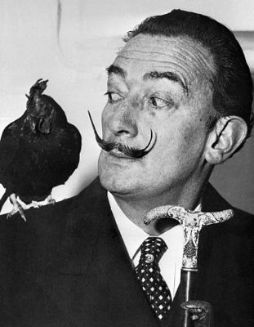
SURREALISM
Exploration of the world of the unconscious
Portrayal of fantasies, dreams, and nightmares
Show the illogical and irrational - disturbing and evocative images
Salvador Dali - Spanish painter/master of Surrealism - The Persistence of Memory (drooping watches)

Slide 14
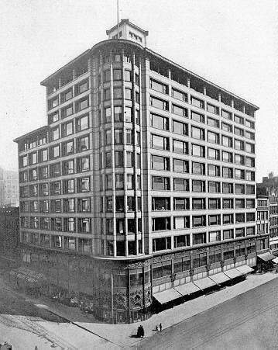
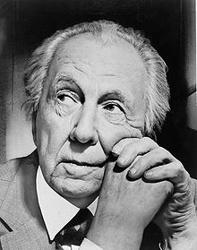
MODERN ARCHITECTURE
Functionalism = buildings should look and be useful/fulfill the purpose for which they were constructed
Rejection of decoration and ornamentation
“Form follows function”
The Chicago School/style of architecture -
Louis Sullivan - “skyscrapers”/the elevator and reinforced concrete and steel
Frank Lloyd Wright - domestic architecture

Slide 15
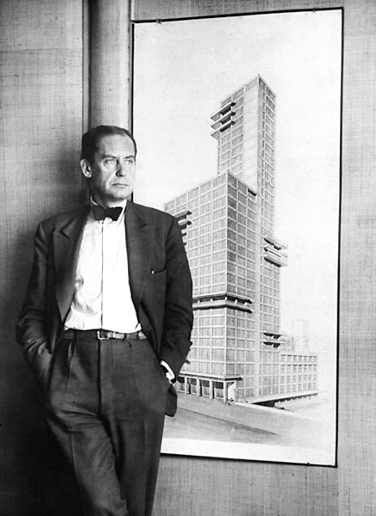
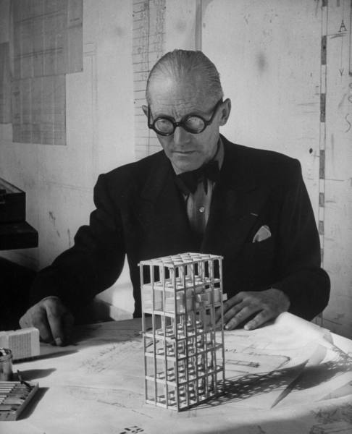
Bauhaus
1. A new school of architecture founded in the 1920’s in Germany
2. Walter Gropius - founder of the Bauhaus
3. Le Corbusier
4. Stripped down unornamented steel, concrete and glass boxes
WALTER GROPIUS
LE CORBUSIER

Slide 16
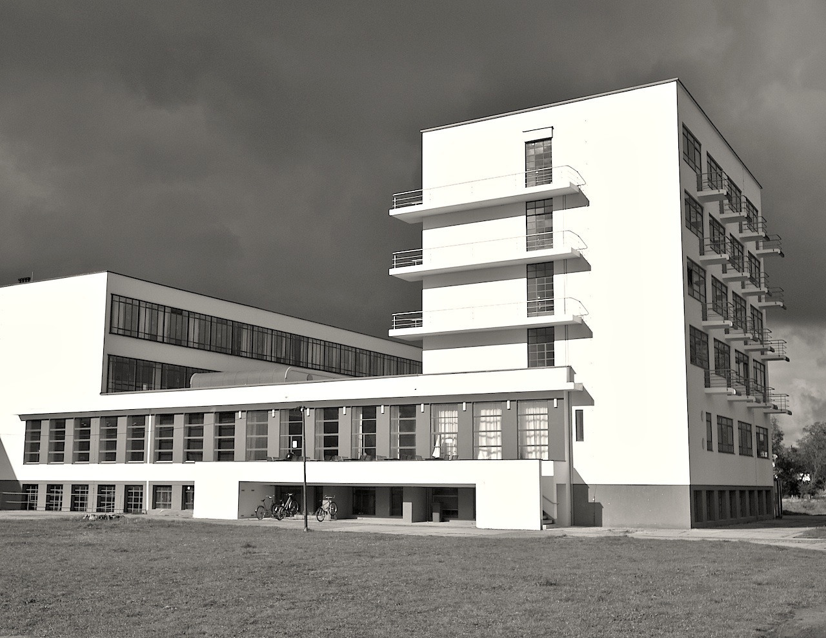
BAUHAUS DESIGN -> MODERNISM IN ARCHITECTURE -> “LESS IS MORE”

Slide 17
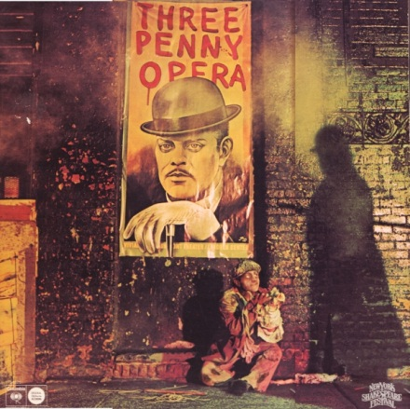
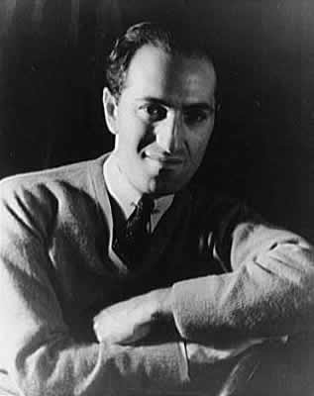
MUSICAL THEATER
1. The blending of popular and classical music and theater
2. Influence of jazz
3. Kurt Weill’s The Threepenny Opera - gangsters and hookers/“Mac the Knife”
4. George Gershwin - Rhapsody in Blue

Slide 18
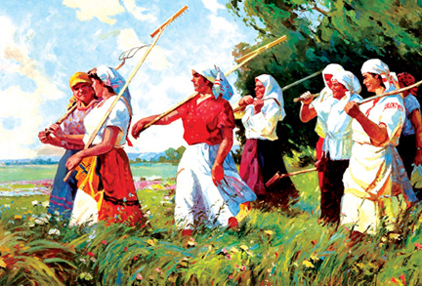
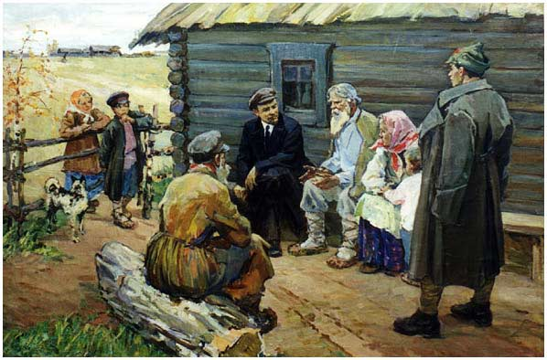
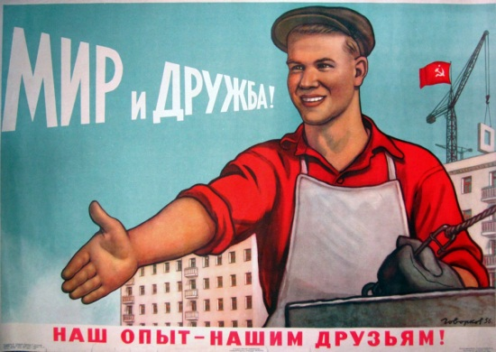
REJECTION OF MODERN ART
Traditionalists denounced modern art as degeneracy and decadence
Hitler and the Nazi said modern art was “degenerate” or “Jewish” art
Nazis favored a 19th century style of art which glorified the strong, healthy and heroic
The Soviet Union - “socialist realism” = a boy and his tractor/brawny factory workers

Slide 19
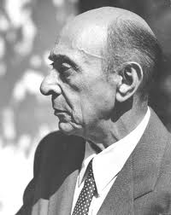
MODERN MUSIC
Started with Stravinsky at the start of the 20th century
Atonal music - radical new style of music
Arnold Schonberg

Slide 20
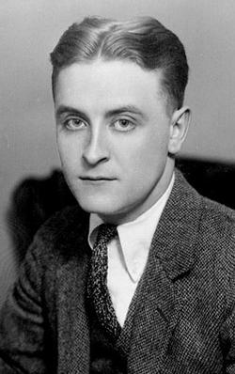
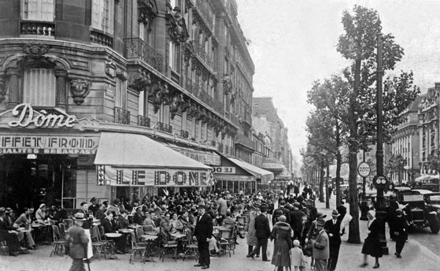
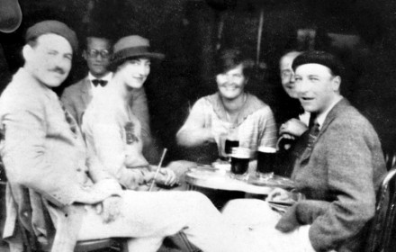
“The Lost Generation”
American writers after WW I
New style of writing - simple and direct/less flowery
F. Scott Fitzgerald - The Great Gatsby
Ernest Hemingway - The Sun Also Rises

Slide 21
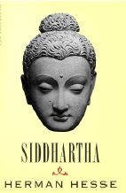
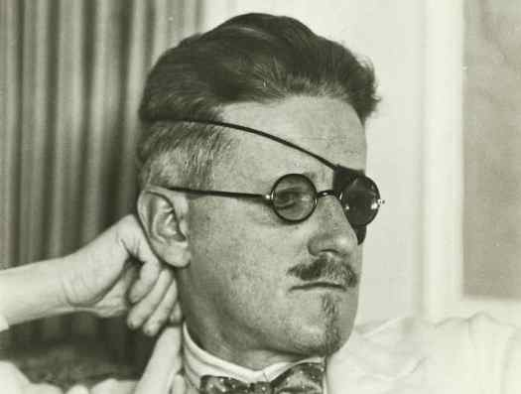
MODERNISM IN LITERATURE
“stream of consciousness” = modernist style of writing/interior monologue
James Joyce -
1. Irish modernist writer
2. Use of stream of consciousness in his writing
3. Ulysses - his masterpiece novel /banned in the USA/ new, shocking, and scandalous
Herman Hesse -
1. German modernist writer
2. Interest and use of psychology in his novels
3. Interest in Eastern religions - Siddhartha
Virginia Woolfe -
1. British modernist writer
2. Use of stream of consciousness
3. Feminism - A Room of One’s Own

Slide 22
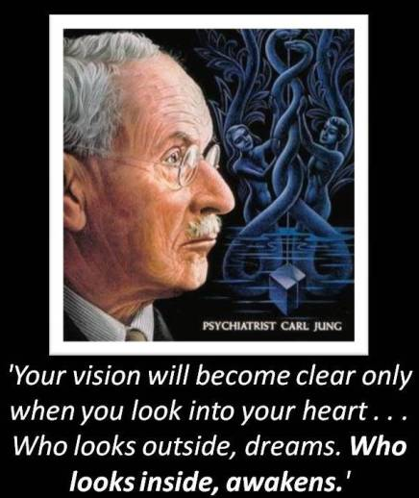
CARL JUNG
Popularization of Freudian ideas
Carl Jung - pupil of Freud’s/collective unconsciousness/ archetypes/myths, religions and philosophy

Slide 23
THE HEROIC AGE OF PHYSICS:
Subatomic research
The splitting of the atom
The road to the atomic bomb
Ernest Rutherford
Werner Heisenberg - the uncertainty principle

