Slide 1
AP EURO: REVIEW SHEET FOR THE MIDTERM ON THE 19TH CENTURY
From Napoleon to the Road to WW I

Slide 2
NAPOLEON BONAPARTE
I was born in Corsica.

Slide 3
NAPOLEON BONAPARTE
Helps overthrow the Directory → coup of Brumaire

Slide 4
CONCORDAT OF 1801
Treaty between the Pope and Napoleon
Reestablishes the Catholic Church in France and gave the Pope limited authority over French clergy
Pope agrees to acknowledge the legitimacy of the French Revolution and Napoleon

Slide 5
NAPOLEON’S GRAND EMPIRE
an enlarged France
Dependent states
Allied states

Slide 6
THOMAS MALTHUS
Author of Principles of Population

Slide 7
POPULATION/FOOD SUPPLY
Malthus said there was an inverse relationship between ________ and _________.

Slide 8
BURSCHENSCHAFTEN
German student groups that desired liberalism and German unification

Slide 9
THE CONTINENTAL SYSTEM
Napoleon’s plan to defeat Britain through economic warfare

Slide 10
THE BATTLE OF TRAFALGAR
Major naval battle of the Napoleonic Wars -> Britain sinks French fleet

Slide 11
WATERLOO
The final battle that defeated Napoleon

Slide 12
THE INDUSTRIAL REVOLUTION
This began in Britain in the mid 18th century

Slide 13
KARLSBAD DECREES
A set of restrictions that shut down the burschenschaften and placed strict control and censorship over German universities

Slide 14
AGRICULTURAL REVOLUTION
This preceded the Industrial Revolution in Britain and created surplus profits and surplus labor

Slide 15
BRITAIN AND THE INDUSTRIAL REVOLUTION
Profits from trade
Geography
Stable government
Laissez-faire
Surplus labor
The ag. Rev.

Slide 16
THE STEAM ENGINE
First used to pump water out of coal mines

Slide 17
HARGREAVE’S SPINNING JENNY
First machine developed to spin cotton into thread

Slide 18
TEXTILES
In what industry was Cartwright’s power loom used?

Slide 19
HENRY CORT
I developed an improved method of manufacturing iron that involved a process called “puddling”

Slide 20
GEORGE STEPHENSON’S ROCKET
I was the first commercial railroad, I ran from Manchester to Liverpool

Slide 21
THE FACTORY SYSTEM
a new way of organizing labor in the industrial revolution – gather workers and machines together

Slide 22
FACTORY DISCIPLINE
Fines and firings for adults
Beatings for children

Slide 23
THE GREAT EXHIBITION OF 1851
It was held in the Crystal Palace in London

Slide 24
CONTINENTAL INDUSTRIALIZATION
This was delayed on the continent because of the French Revolution and Napoleonic Wars

Slide 25
DIFFERENCES BETWEEN BRITISH AND CONTINENTAL INDUSTRIALIZATION
Britain = private individuals
Continental Europe = governments and big banks

Slide 26
THE IRISH FAMINE – POTATO BLIGHT
This caused massive starvation in Ireland in the “hungry forties“

Slide 27
EDWIN CHADWICK – SANITARY REFORM
I advocated piped water and sewerage to improve the cities

Slide 28
NEW SOCIAL CLASSES OF THE INDUSTRIAL REVOLUTION

Slide 29
CHARTISM AND THE PEOPLE’S CHARTER
This was a movement for voting rights and reform of parliament in Britain -> it failed

Slide 30
LUDDITES
Artisans who protested industrialization and attacked and destroyed machines

Slide 31
THE CONGRESS OF VIENNA
Organized by the quadruple alliance to restore the balance of power and the old regimes following the defeat Napoleon

Slide 32
KLEMENS VON METTERNICH
I was organizer and mastermind of the Congress of Vienna

Slide 33
CONSERVATISM
This ideology hated radical change, liberalism, and nationalism

Slide 34
THE GREEK REVOLT
This was the only revolution that the old regimes supported

Slide 35
THE PETERLOO MASSACRE
Innocent peaceful protesters were shot down in Britain

Slide 36
IGNORE THE PARLIAMENT
How did Bismarck win the “constitutional struggle” in Prussia

Slide 37
THE KARLSBAD DECREES
These were imposed on the German states by Metternich -> they cracked down on liberalism and nationalism

Slide 38
THOMAS MALTHUS
I believed that it was fruitless and pointless to help or feed the poor

Slide 39
DAVID RICARDO
The iron law of wages

Slide 40
ECONOMIC LIBERALISM
This is another name for laissez-faire or free market economics -> govt should stay out of the economy

Slide 41
LIBERALISM
Natural rights
Constitutions
Limited governments
Limited voting = property owners
Civil liberties
Religious toleration

Slide 42
UTOPIAN SOCIALISM
Charles Fourier
Louis Blanc
Saint-Simon

Slide 43
NATIONALISM

Slide 44
THE REFORM BILL OF 1832

Slide 45
THE REVOLUTIONS OF 1848

Slide 46
THE FRANKFURT ASSEMBLY

Slide 47
GUISEPPE MAZZINI – YOUNG ITALY

Slide 48
ROMANTICISM
Reaction against industrialization
Reaction against enlightenment
Focus on feeling, impulse, the heart not the head
Worship of nature
Fascinated by the supernatural and the grotesque
Fascinated with the past – the medieval

Slide 49
THE BRITISH ROMANTIC POETS

Slide 50
ROMANTICISM IN ART
Landscapes and nature

Slide 51
ROMANTICISM IN ARCHITECTURE
NeoGothic

Slide 52
NAPOLEON III AND THE 2ND EMPIRE

Slide 53
THE CRIMEAN WAR
Russia versus Ottoman Empire
British and French join Ottomans
Balance of power conflict
End of the concert of Europe
Opens up competition between great powers and Italian and German unification

Slide 54
ITALIAN UNIFICATION

Slide 55
PIEDMONT AND CAVOUR

Slide 56
GARIBALDI AND THE RED SHIRTS

Slide 57
GERMAN UNIFICATION

Slide 58
OTTO VON BISMARCK

Slide 59
BISMARCK’S WARS
The Danish War
The Austro-Prussian War
Franco-Prussian War

Slide 60
THE BATTLE OF SEDAN

Slide 61
THE GERMAN EMPIRE AND KAISER WILLIAM I
I became the first ruler of unified Germany

Slide 62
THE AUSGLEICH
The Compromise of 1867 → created the dual monarchy of Austria-Hungary

Slide 63
THE REFORMS OF ALEXANDER II
Emancipation of the Serfs

Slide 64
THE PEOPLE’S WILL
This group assassinated Tsar Alexander II

Slide 65
VICTORIAN ENGLAND
This was mid to late 19th century England

Slide 66
WILLIAM GLADSTONE

Slide 67
BENJAMIN DISRAELI

Slide 68
REFORM ACT OF 1867

Slide 69
KARL MARX AND COMMUNISM

Slide 70
THE CLASS STRUGGLE

Slide 71
HEGEL’S DIALECTIC
Thesis
Antithesis
Synthesis

Slide 72
BOURGEOISIE AND PROLETARIAT
These are the Marxist terms for the workers and the owners

Slide 73
CHARLES DARWIN
I am the father of organic/biological evolution

Slide 74
REALISM
This followed and rejected romanticism

Slide 75
THE SECOND INDUSTRIAL REVOLUTION
Steel
Chemicals
Petroleum
electricity

Slide 76
EUROPEAN ZONES OF ECONOMIC/INDUSTRIAL DEVELOPMENT
Northern/Western Europe – industrialized and high standard of living
Southern/Eastern Europe – nonindustrialized and low standard of living

Slide 77
MARXIST REVISIONISM
Eduard Bernstein

Slide 78
ANARCHISM
Bakunin -> what’s my –ism?

Slide 79
DOMESTIC POLICIES OF BISMARCK
Battle against Catholics = kulturkampf
Battle against socialism
Create government social welfare programs to win the support of the working class

Slide 80
NICHOLAS II
He was forced by the Revolution of 1905 to issue the October Manifesto creating a liberal constitutional monarchy in Russia

Slide 81
THE NEW PHYSICS
The Curies
Einstein
Planck

Slide 82
FRIEDRICH NIETZSCHE
He glorified the irrational
Hated bourgeois life
Said that Christianity is a slave morality

Slide 83
SIGMUND FREUD
I am the father of modern psychology -> I was one of the first to probe the mysteries of the unconscious mind

Slide 84
INTERPRETATION OF DREAMS
This was Freud first book on how to unlock the secrets of the unconscious/subconscious mind

Slide 85
ID, EGO, SUPEREGO
According to Freud the psyche/mind is made up of these three parts

Slide 86
SOCIAL DARWINISM
Applying Darwinist ideas to races, classes, cultures, and nations to justify inequality

Slide 87
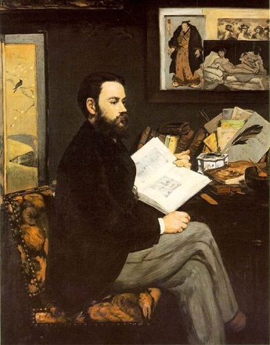
NATURALISM
Style of writing which dominated the late 19th century
Was a continuation of Realism which dominated the mid-century
Portray the world as is really is
More pessimistic
EMILE
ZOLA

Slide 88
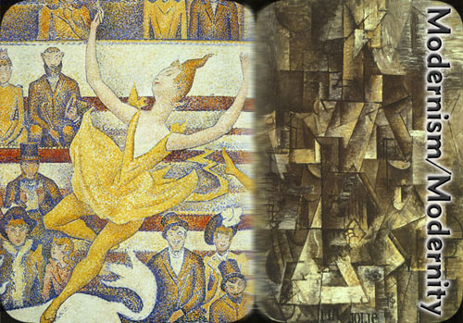
MODERNISM IN THE ARTS
Modernism was new and different in that for the first time since the Renaissance artists moved away from trying to represent reality as accurately as possible
Modernism was the search for new forms of artistic expression

Slide 89
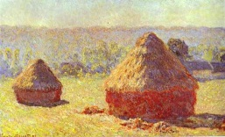
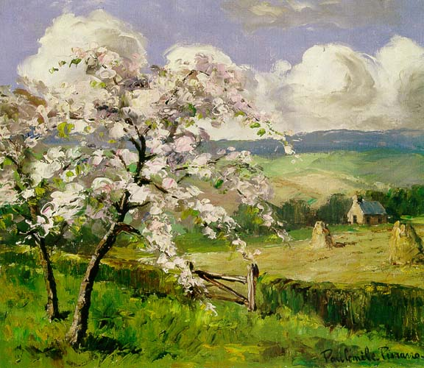
IMPRESSIONISM
France 1870’s
Paint the impressions of the changing effects of light on objects in nature
CAMILLE PISSARRO
CLAUDE MONET

Slide 90
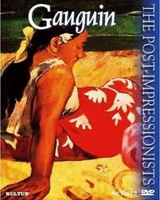
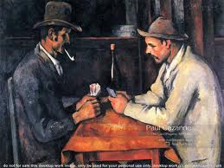
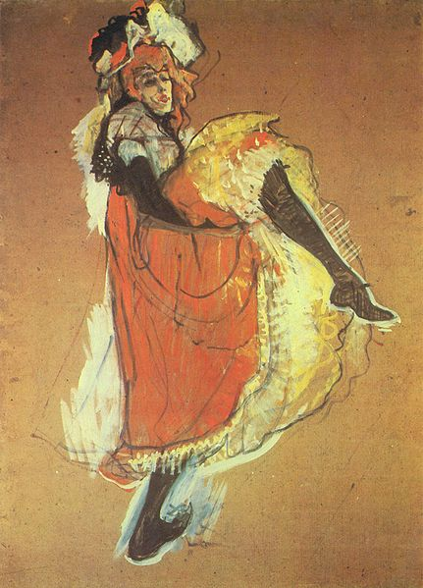
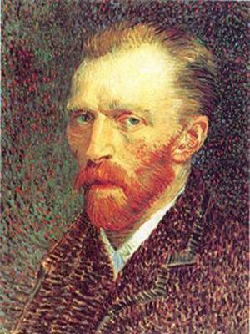
POST-IMPRESSIONISM
France 1880’s
Paul Cezanne
Vincent Van Gogh
Paul Gauguin
Toulouse Lautrec

Slide 91
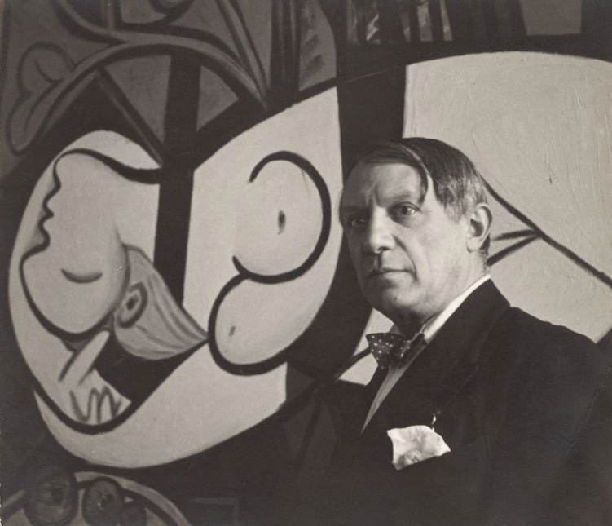
PABLO PICASSO - CUBISM
One of the most important painters of 20th century
Spanish painter
Moves to Paris
Objects are broken up, analyzed, and reassembled in an abstracted form
1st cubist painting – LES DEMOISELLES d’AVIGNON

Slide 92
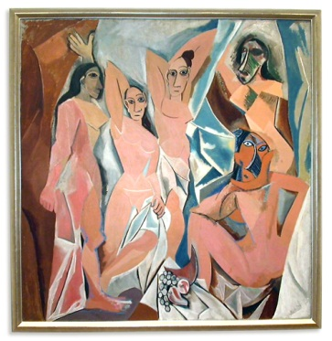

Slide 93
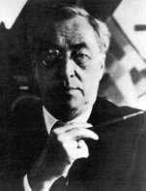
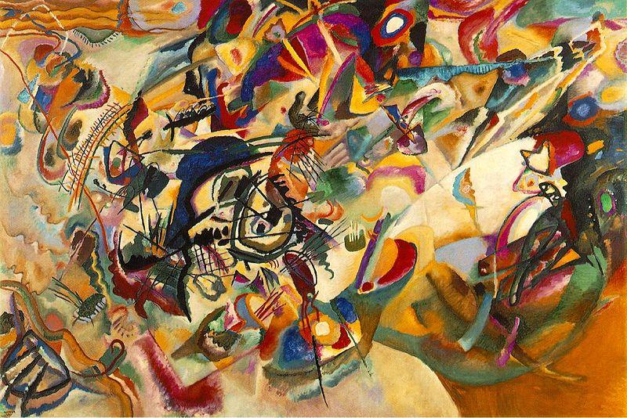
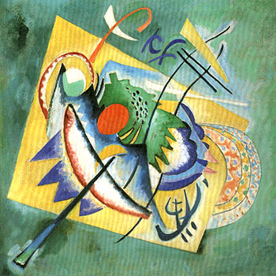
ABSTRACT PAINTING
non-representational painting
Rejection of visual reality
Wassily Kandinsky

Slide 94
EUROPEAN JEWS
ANTI-SEMITISM still existed
The ideals of the Enlightenment and French Rev led to increased legal equality for the Jews in many countries
Jews were emancipated in central and Western Europe → a. leave the ghetto
b. ASSIMILATE = blend in with everyone else
c. access to university and govt
4. anti-Semitism and pogroms in Eastern Europe

Slide 95
ZIONISM - THEODOR HERZL
Jewish nationalist movement
Advocated a return to Palestine = the ancient land of the Jews
Theodor Herzl = the father of political Zionism
Goal of Zionism→ create an independent homeland/nation for the Jews in Palestine

Slide 96
THE RUSSO-JAPANESE WAR 1905
Russia versus Japan → who will be the dominant power in East Asia/the Eastern Pacific
Russia loses the war → shocking! → brown people defeat Europeans for the 1st time
Russia’s defeat leads to the Revolution of 1905

Slide 97
THE REVOLUTION OF 1905

Slide 98
THE BISMARCKIAN SYSTEM OF ALLIANCES
Bismarck/Germany → make military alliances with all the great powers in Europe → leave France isolated and alone

Slide 99
THE TRIPLE ALLIANCE
Alliance between
Germany
Austria
Italy → Drops out and is replaced by Ottoman Empire
* The Central Powers in WW I

Slide 100
THE TRIPLE ENTENTE
France
Britain
Russia
* Allied Powers in WW I

Slide 101
CRISIS AND CONFLICT IN THE BALKANS
Three wars fought in the Balkans
The problem was nationalism
The Balkans = the powder keg of Europe
Main enemies in the Balkans were Austria and Serbia

Slide 102
SERBS v. AUSTRIANS
The source of conflict between the two was the region called Bosnia-Herzegovina → Austria annexes it but Serbia wants it→ problems coming = WW I

Slide 103
THE ROAD TO WW I
Austria v. Serbia
Austria backed up by Germany
Serbia backed up Russia
Germany hates/fears Russia & Russia hates/fears Germany
France hates/fears Germany

